Slide 1


Mahmoud AlFares
10 Feb 2023

Slide 2

Outline
Executive Summary
Introduction
Methodology
Results
Conclusion
Appendix

Slide 3

Executive Summary
Summary of methodologies
Data Collection through API
Data Collection with Web Scraping
Data Wrangling
Exploratory Data Analysis with SQL
Exploratory Data Analysis with Data Visualization
Interactive Visual Analytics with Folium
Machine Learning Prediction
Summary of all results
Exploratory Data Analysis result
Interactive analytics in screenshots
Predictive Analytics result

Slide 4
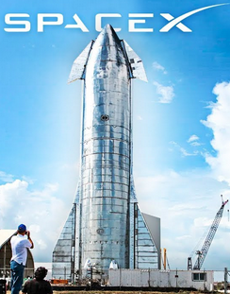
Introduction
Project background and context
Space X advertises Falcon 9 rocket launches on its website with a cost of 62 million dollars; other providers cost upward of 165 million dollars each, much of the savings is because Space X can reuse the first stage. Therefore, if we can determine if the first stage will land, we can determine the cost of a launch. This information can be used if an alternate company wants to bid against space X for a rocket launch. This goal of the project is to create a machine learning pipeline to predict if the first stage will land successfully
Problems you want to find answers
What factors determine if the rocket will land successfully?
The interaction amongst various features that determine the success rate of a successful landing.
What operating conditions needs to be in place to ensure a successful landing program.

Slide 5

Section 1

Slide 6
Methodology
Executive Summary
Data collection methodology:
Describe how data was collected
Perform data wrangling
Describe how data was processed
Perform exploratory data analysis (EDA) using visualization and SQL
Perform interactive visual analytics using Folium and Plotly Dash
Perform predictive analysis using classification models
How to build, tune, evaluate classification models

Slide 7

Data Collection
In this project we working on Data Collection using various methods as following:
First, using get request to the SpaceX API.
Next, we decoded the response content as a Json using .json().
Then turn it into a pandas dataframe using .json_normalize().
After that, we cleaned the data, checked for missing values and fill in missing values where necessary.
In addition, we performed web scraping from Wikipedia for Falcon 9 launch records with BeautifulSoup.
Finally, we extracted the launch records as HTML table, parse the table and convert it to a pandas dataframe for future analysis.

Slide 8

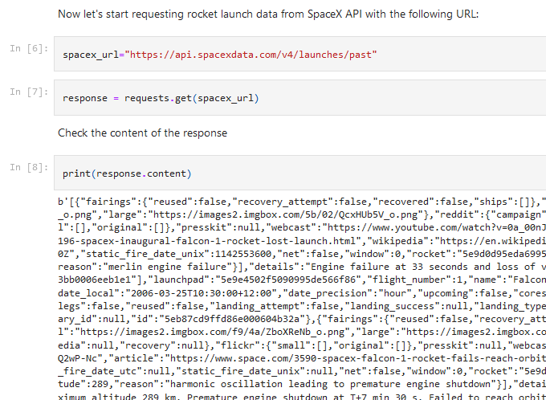
Data Collection – SpaceX API
We used the get request to the SpaceX API to collect data, clean the requested data and did some basic data wrangling and formatting.
The link to the notebook is https://github.com/Mfaress/IBM_DS_Capstone/blob/main/IBM_Week%201A-%20Data%20Collection%20API%20Lab%20.ipynb

Slide 9
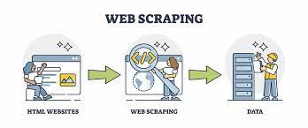
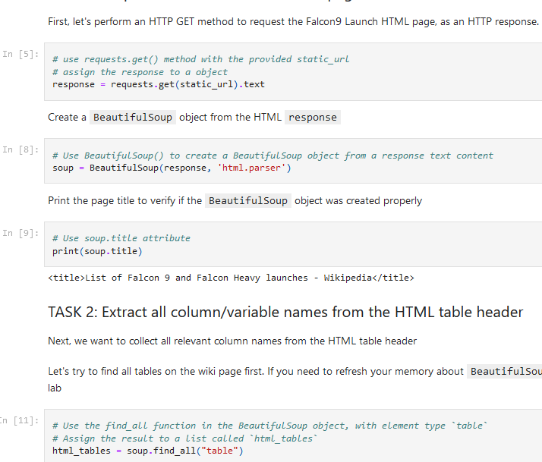
Data Collection - Scraping
We applied web scrapping to webscrap Falcon 9 launch records with BeautifulSoup, then we parsed the table and converted it into a pandas dataframe.
The link to the notebook is
https://github.com/Mfaress/IBM_DS_Capstone/blob/main/IBM_Week%201B%20-%20Web%20Scraping.ipynb

Slide 10
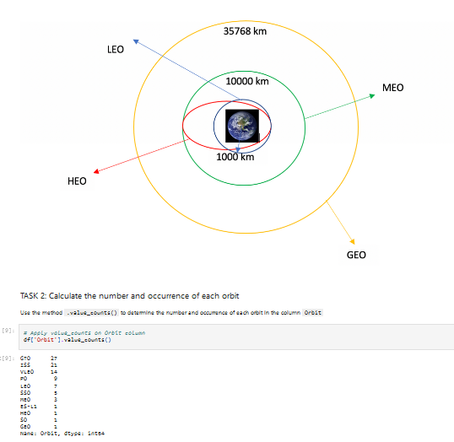
Data Wrangling
We performed exploratory data analysis and determined the training labels.
We calculated the number of launches at each site, and the number and occurrence of each orbits
We created landing outcome label from outcome column and exported the results to csv.
The link to the notebook is https://github.com/Mfaress/IBM_DS_Capstone/blob/main/IBM_Week%201C%20-%20Data%20Wrangling.ipynb

Slide 11
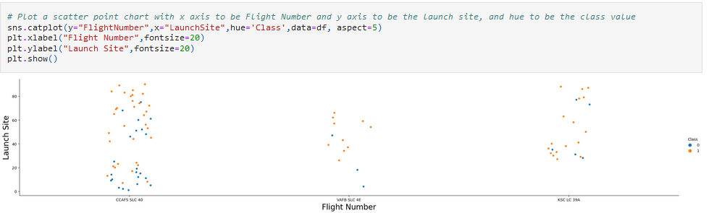
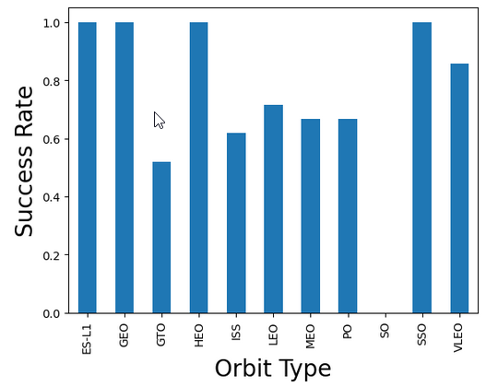
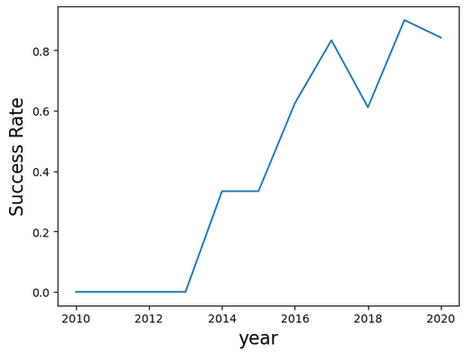
EDA with Data Visualization
We rendered scatter plots and bar plots to visualize the relationship between pair of features:
Payload Mass vs Flight Number
Launch Site vs Flight Number
Launch Site vs Payload Mass
Orbit vs Flight Number
Payload vs Orbit
https://github.com/Mfaress/IBM_DS_Capstone/blob/main/IBM_Week%202B%20-%20EDA%20with%20Visualization%20lab.ipynb.ipynb

Slide 12
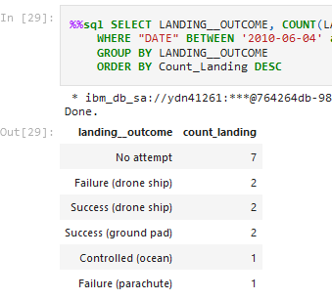
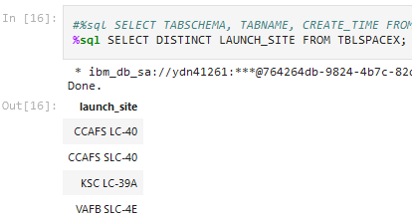
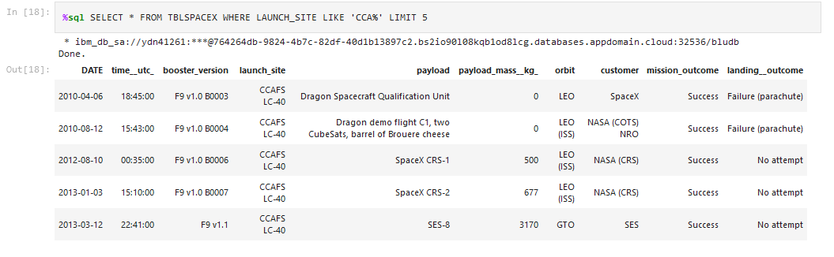
EDA with SQL
We used SQL queries to:
Display the names of the unique launch sites in the space mission
Display 5 records where launch sites begin with the string 'CCA’
Display the total payload mass carried by boosters launched by NASA (CRS)
Display average payload mass carried by booster version F9 v1.1
List the date when the first successful landing outcome in ground pad was achieved.
List the names of the boosters which have success in drone ship and have payload mass greater than 4000 but less than 6000
List the total number of successful and failure mission outcomes
List the names of the booster versions which have carried the maximum payload mass.
https://github.com/Mfaress/IBM_DS_Capstone/blob/main/IBM_Week%202A%20-%20EDA%20with%20SQL.ipynb

Slide 13
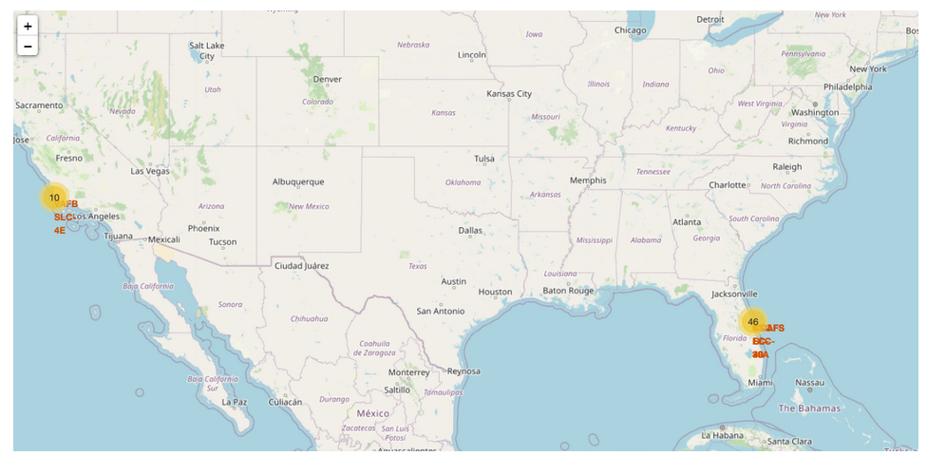
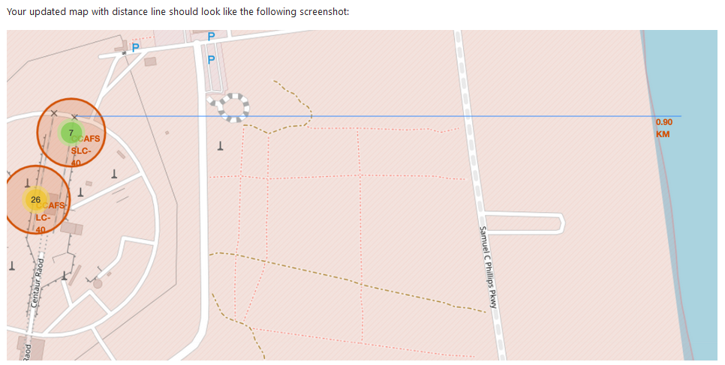
Build an Interactive Map with Folium
We used Latitude and Longitude Coordinates at each launch site to Visualizie the Launch Data into an interactive map and added a Circle Marker around each launch site with a label of the name of the launch site.
We assigned the feature launch outcomes (failure or success) to class 0 and 1.i.e., 0 for failure, and 1 for success.
Then we calculated the distance from the Launch Site to various landmarks to find various trends about what is around the Launch Site to measure patterns. Linesare drawn on the map to measure distance to landmarks
We calculated the distances between a launch site to its proximities. We answered some question for instance:
Are launch sites near railways, highways and coastlines.
Do launch sites keep certain distance away from cities.
Git URL: https://github.com/Mfaress/IBM_DS_Capstone/blob/main/IBM_Week%203%20-%20Visual%20Analytics%20with%20Folium%20lab.ipynb

Slide 14
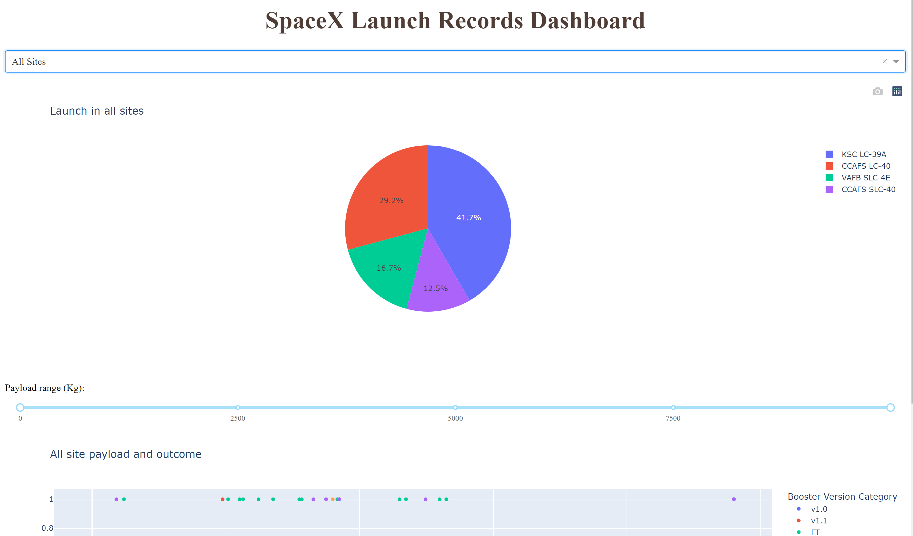
Build a Dashboard with Plotly Dash
We used Plotly dash to build our Dashboard
The dashboard allowed us to quickly analyse the relationship between payloads and launch sites, helping us to identify the best launch sites by payload mass
We plotted pie charts showing the total launches by a certain sites
We plotted scatter graph showing the relationship with Outcome and Payload Mass (Kg) for the different booster version.
https://github.com/Mfaress/IBM_DS_Capstone/blob/main/IBM_Week%203B-Dashboard%20with%20Ploty%20Dash.py

Slide 15
Predictive Analysis (Classification)
Building the Model
Load the dataset into NumPy and Pandas
Evaluating the Model
Check the accuracy for each model
Improving the Model
Use Feature Engineering
Transform the data and then split into training and test datasets
Decide which type of ML to use
set the parameters and algorithms to GridSearchCV and fit it to dataset.
Get tuned hyperparameters for each type of algorithms.
plot the confusion matrix
and Algorithm Tuning
The model with the best accuracy score will be the best performing model.
Find the Best Model
http://localhost:8888/notebooks/Desktop/IBM_DS-Capstone/Python%20code/IBM_Week%204%20-%20Machine%20Learning%20Prediction%20lab.ipynb

Slide 16
Results
Exploratory data analysis results
Interactive analytics demo in screenshots
Predictive analysis results

Slide 17

Section 2

Slide 18
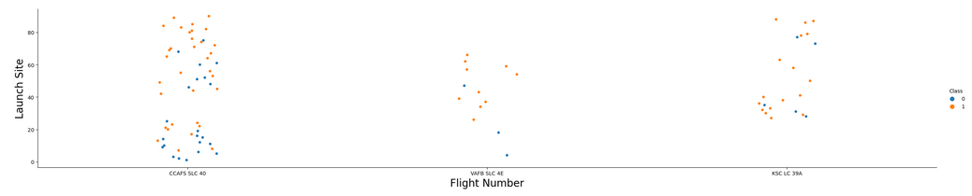
Flight Number vs. Launch Site
we found that the larger the flight amount at a launch site, the greater the success rate at a launch site

Slide 19
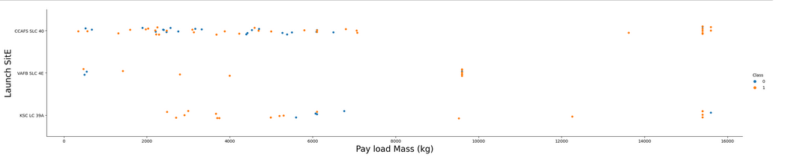
Payload vs. Launch Site
Higher payloads (over 12,000kg) have a better success rate at CCAFS SLC 40 and KSC LC 39A launch sites

Slide 20
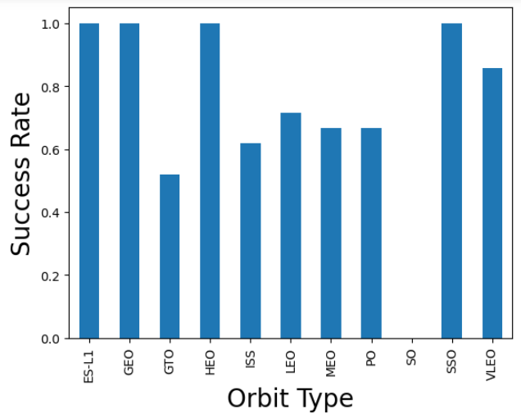
Success Rate vs. Orbit Type
From the plot, we can see that ES-L1, GEO, HEO, SSO, VLEO had the most success rate.

Slide 21
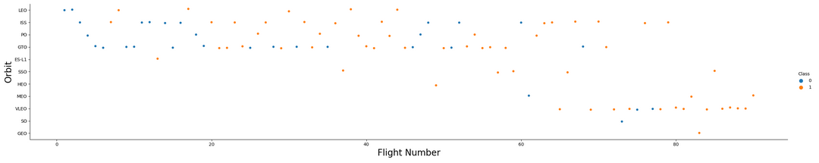
Flight Number vs. Orbit Type
We observe that in the LEO orbit, success is related to the number of flights, on the
other hand, there seems to be no relationship between flight number when in GTO orbit.

Slide 22
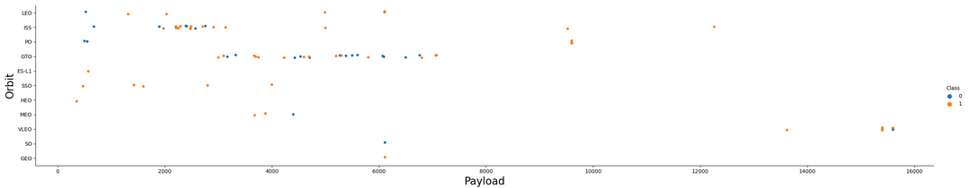
Payload vs. Orbit Type
Heavy payloads have a negative influence on GTO orbits and positive on GTO and Polar LEO (ISS) orbits.

Slide 23
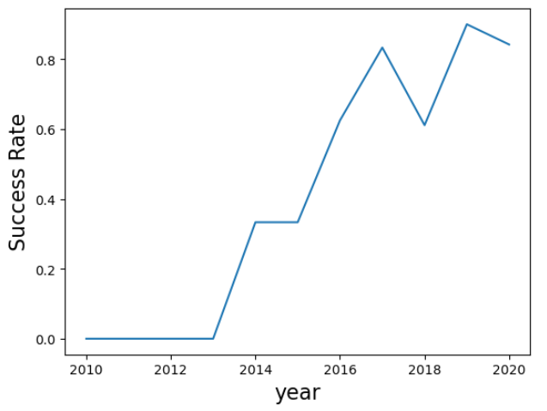
Launch Success Yearly Trend
we can observe that success rate since 2013 kept on increasing till 2020

Slide 24
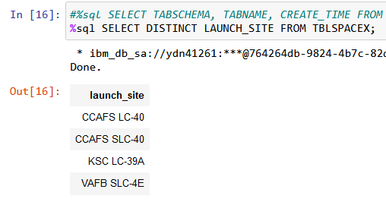
All Launch Site Names
We used the key word DISTINCT to show only unique launch sites from the SpaceX data.

Slide 25
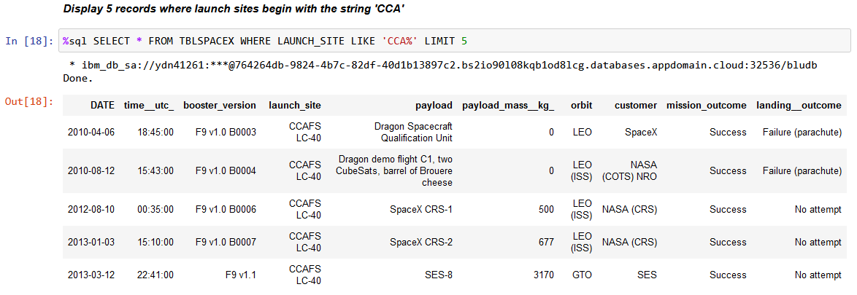
Launch Site Names Begin with 'CCA'
We used the query above to display 5 records where launch sites begin with `CCA`

Slide 26
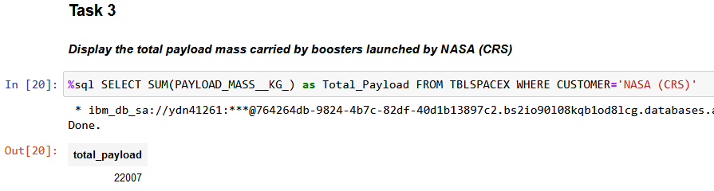
Total Payload Mass
We found the total payload carried by boosters from NASA that equal 22007

Slide 27
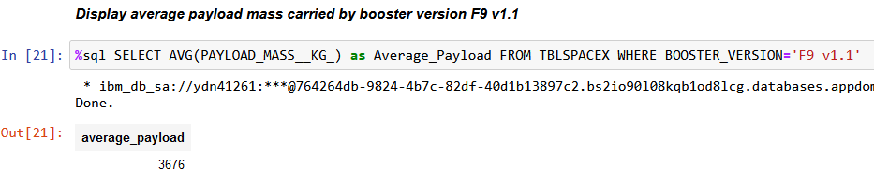
Average Payload Mass by F9 v1.1
We found the Average Payload Mass by F9 v1.1 that equal 3676

Slide 28
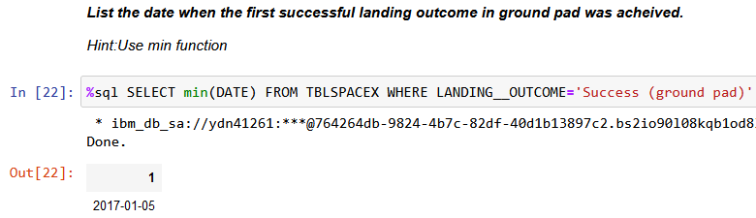
First Successful Ground Landing Date
We found the First Successful Ground Landing Date is 2017-01-05

Slide 29
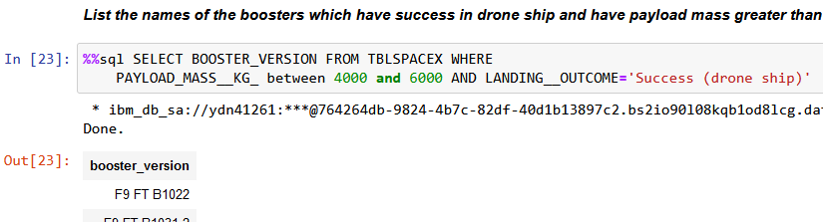
Successful Drone Ship Landing with Payload between 4000 and 6000
We used the WHERE clause to filter for boosters which have successfully landed on drone ship and applied the AND condition to determine successful landing with payload mass greater than 4000 but less than 6000

Slide 30
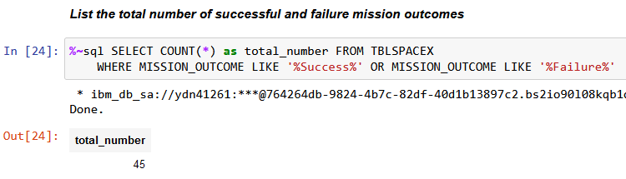
Total Number of Successful and Failure Mission Outcomes
We used wildcard like ‘%’ to filter for WHERE Mission_Outcome was a success or a failure.

Slide 31
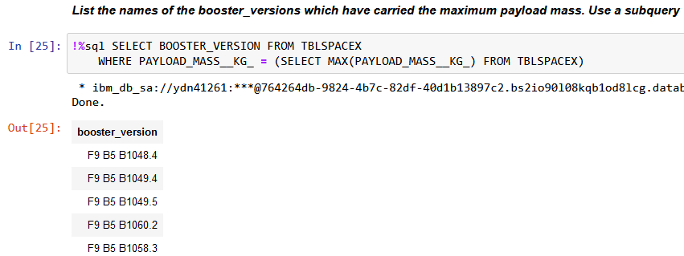
Boosters Carried Maximum Payload
We determined the booster that have carried the maximum payload
using a subquery in the WHERE clause and the MAX() function.

Slide 32
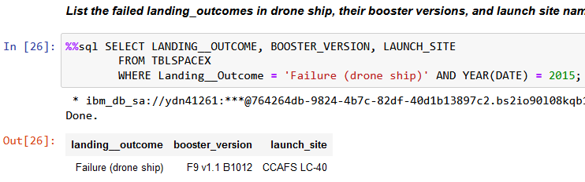
2015 Launch Records
We used a combinations of the WHERE clause, LIKE, AND, and BETWEEN conditions to filter for failed landing outcomes in drone ship, their booster versions, and launch site names for year 2015

Slide 33
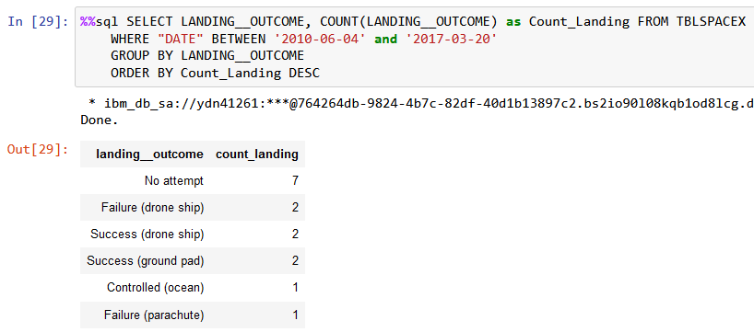
Rank Landing Outcomes Between 2010-06-04 and 2017-03-20
We selected Landing outcomes and the COUNT of landing outcomes from the data and used the WHERE clause to filter for landing outcomes BETWEEN 2010-06-04 to 2010-03-20.

Slide 34

Section 3

Slide 35
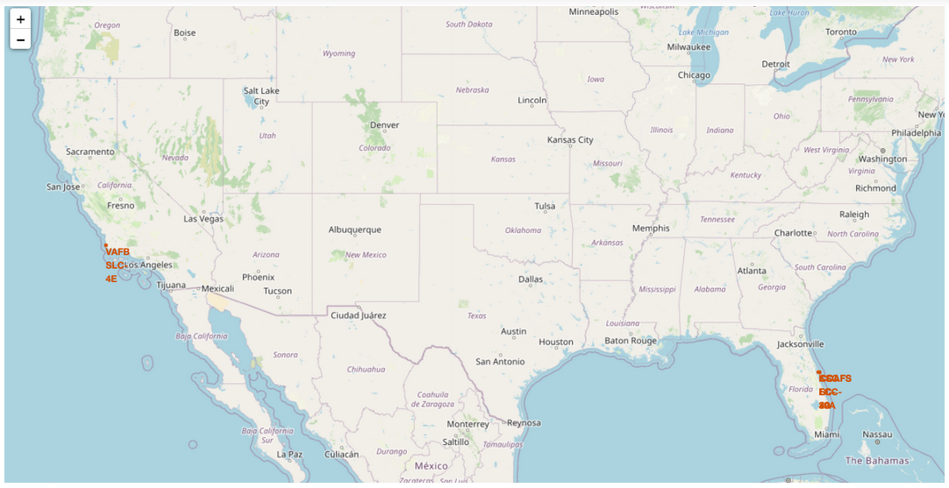
All launch sites

Slide 36
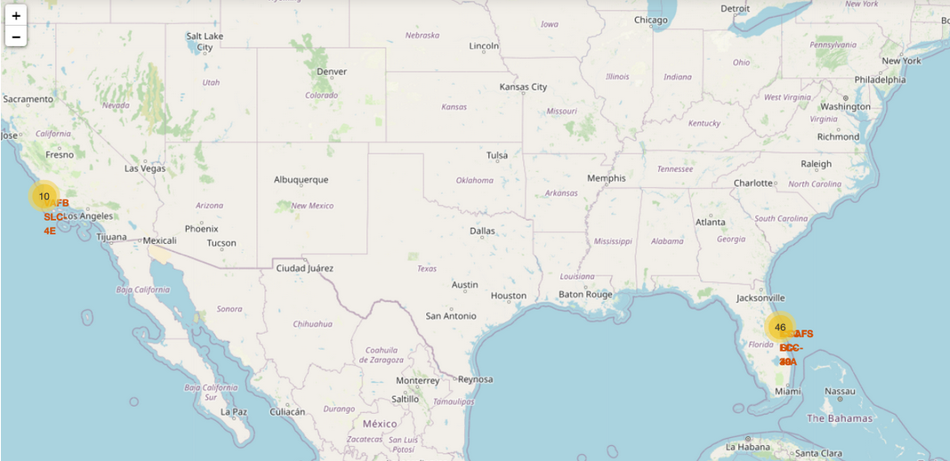
Launch outcome by launch site

Slide 37
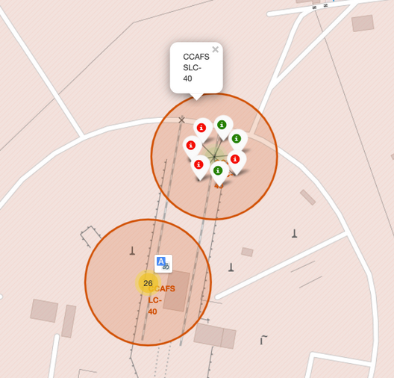
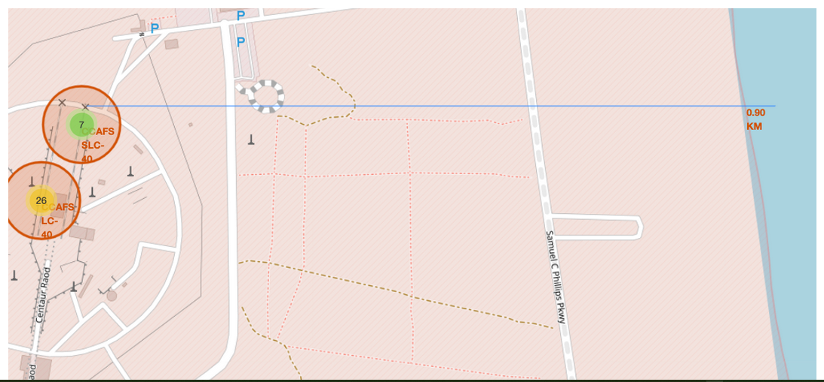
Launch Site distance to landmarks

Slide 38

Section 4

Slide 39

Pie chart showing the success percentage achieved by each launch site

Slide 40

Launch Success Ratio for KSC LC-39A

Slide 41

Scatter plot of Payload vs Launch Outcome for all sites,
with different payload selected in the range slider

Slide 42

Section 5

Slide 43
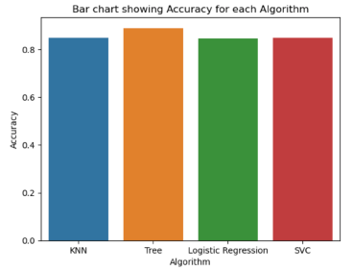
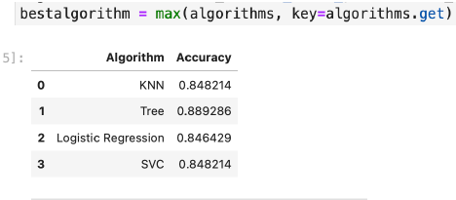
Classification Accuracy

Slide 44
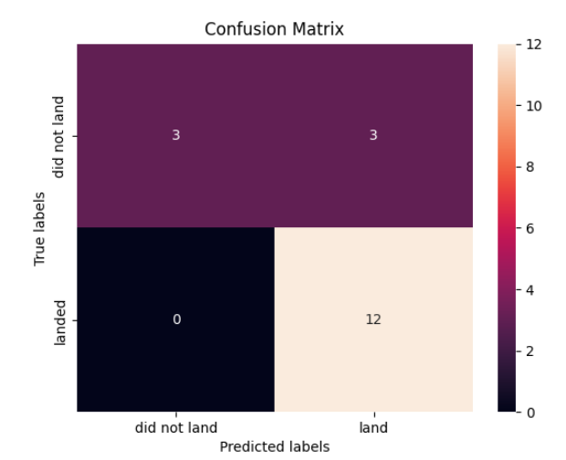
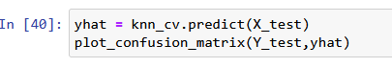
Confusion Matrix
The Decision Tree confusion matrix shows the largest number of true positive and true negative compared to other models

Slide 45
Conclusions
The larger the flight amount at a launch site, the greater the success rate at a launch site.
Launch success rate started to increase in 2013 till 2020.
Orbits ES-L1, GEO, HEO, SSO, VLEO had the most success rate.
KSC LC-39A had the most successful launches of any sites.
The Tree Classifier Algorithm is the best for Machine Learning for this dataset

Slide 46
Appendix
https://github.com/Mfaress/IBM_DS_Capstone
https://www.coursera.org/learn/applied-data-science-capstone
https://www.coursera.org/professional-certificates/ibm-data-science
https://cloud.ibm.com/

Slide 47


